Slide 1
NoSQL Database
Prof Jigna Patel,
CSE Department, Institute of Technology
Nirma University

Slide 2
RDBMS
Atomic
Consistent
Isolated
Durable

Slide 3
Distributed Systems - Advantages
Reliability (fault tolerance)
Scalability
Sharing of Resources
Flexibility
Speed
Open system
Performance

Slide 4
Distributed Systems - Disadvantages
Troubleshooting
Software
Networking
Security

Slide 5
Big Data Evolution
Scalability
Vertical Scaling
Horizontal Scaling

Slide 6
What is NoSQL
Class of database management systems (DBMS)
"Not only SQL"
Does not use SQL as querying language
Distributed, fault-tolerant architecture
No fixed schema (formally described structure)
No joins (typical in databases operated with SQL)
Expensive operation for combining records from
two or more tables into one set
Joins require strong consistency and fixed schemas
Lack of these makes NoSQL databases more flexible
It's not a replacement for a RDBMS but compliments it

Slide 7
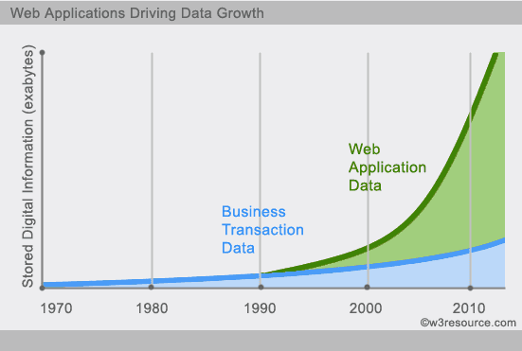
Why NoSQL ?

Slide 8
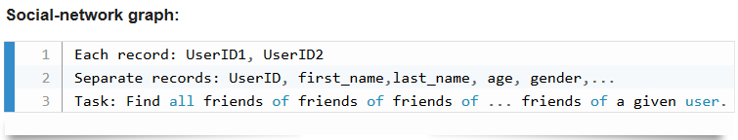
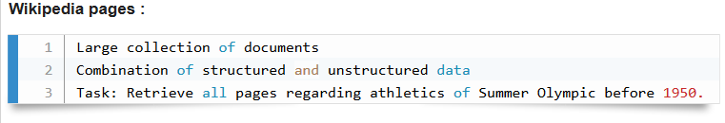
Why NoSQL ?

Slide 9
RDBMS vs NoSQL
RDBMS | NoSQL
- Structured and organized data - Structured query language (SQL) - Data and its relationships are stored in separate tables. - Data Manipulation Language, Data Definition Language - Tight Consistency | - Stands for Not Only SQL - No declarative query language - No predefined schema - Key-Value pair storage, Column Store, Document Store, Graph databases - Eventual consistency rather ACID property - Unstructured and unpredictable data - CAP Theorem - Prioritizes high performance, high availability and scalability - BASE Transaction

Slide 10
History of NoSQL
The term NoSQL was coined by Carlo Strozzi in the year 1998
In the early 2009, when last.fm wanted to organize an event on open-source distributed databases, Eric Evans, a Rackspace employee.
In the same year, the "no:sql(east)" conference held in Atlanta, USA, NoSQL was discussed and debated a lot
And then, discussion and practice of NoSQL got a momentum, and NoSQL saw an unprecedented growth.

Slide 11
CAP Theorem (Brewer’s Theorem)
Consistency - This means that the data in the database remains consistent after the execution of an operation. For example after an update operation all clients see the same data.
Availability - This means that the system is always on (service guarantee availability), no downtime.
Partition Tolerance - This means that the system continues to function even the communication among the servers is unreliable, i.e. the servers may be partitioned into multiple groups that cannot communicate with one another.

Slide 12
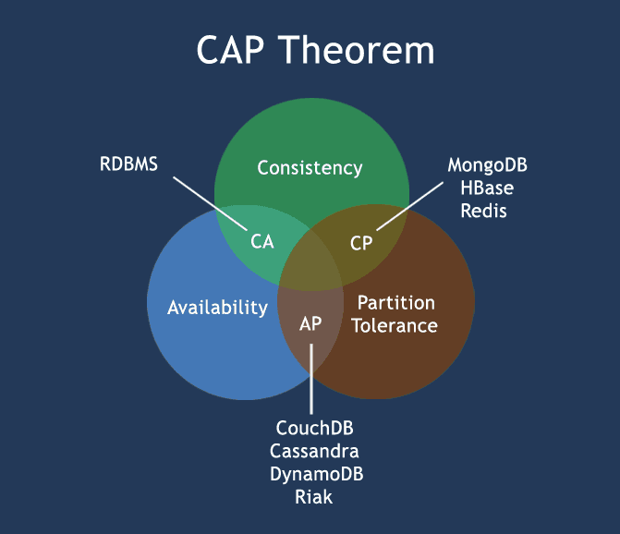

Slide 13
Consistency — A guarantee that every node in a distributed cluster returns the same, most recent, successful write. Consistency refers to every client having the same view of the data. There are various types of consistency models. Consistency in CAP (used to prove the theorem) refers to linearizability or sequential consistency, a very strong form of consistency.

Slide 14
Availability — Every non-failing node returns a response for all read and write requests in a reasonable amount of time. The key word here is every. To be available, every node on (either side of a network partition) must be able to respond in a reasonable amount of time.

Slide 15
Partition Tolerant — The system continues to function and upholds its consistency guarantees in spite of network partitions. Network partitions are a fact of life. Distributed systems guaranteeing partition tolerance can gracefully recover from partitions once the partition heals.

Slide 16
CP (Consistent and Partition Tolerant) — At first glance, the CP category is confusing, i.e., a system that is consistent and partition tolerant but never available. CP is referring to a category of systems where availability is sacrificed only in the case of a network partition.

Slide 17
CA (Consistent and Available) — CA systems are consistent and available systems in the absence of any network partition. Often a single node's DB servers are categorized as CA systems. Single node DB servers do not need to deal with partition tolerance and are thus considered CA systems. The only hole in this theory is that single node DB systems are not a network of shared data systems and thus do not fall under the preview of CAP

Slide 18
AP (Available and Partition Tolerant) — These are systems that are available and partition tolerant but cannot guarantee consistency.

Slide 19
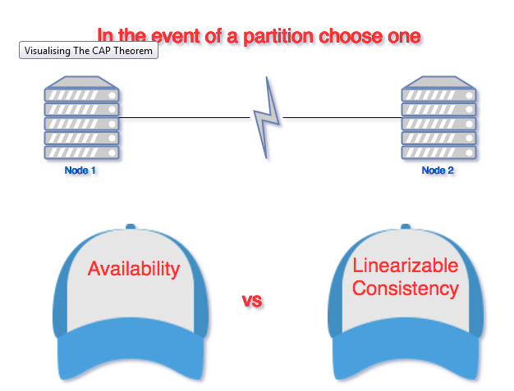

Slide 20
CAP Theorem
CA - Single site cluster, therefore all nodes are always in contact. When a partition occurs, the system blocks.
CP -Some data may not be accessible, but the rest is still consistent/accurate.
AP - System is still available under partitioning, but some of the data returned may be inaccurate.

Slide 21
NoSQL pros/cons
Advantages :
High scalability
Distributed Computing
Lower cost
Schema flexibility, semi-structure data
No complicated Relationships

Slide 22
NoSQL pros/cons
Disadvantages :
No standardization
Limited query capabilities (so far)
Eventual consistent is not intuitive to program for

Slide 23
The BASE
A BASE system gives up on consistency.
Basically Available indicates that the system does guarantee availability, in terms of the CAP theorem.
Soft state indicates that the state of the system may change over time, even without input. This is because of the eventual consistency model.
Eventual consistency indicates that the system will become consistent over time, given that the system doesn't receive input during that time.

Slide 24
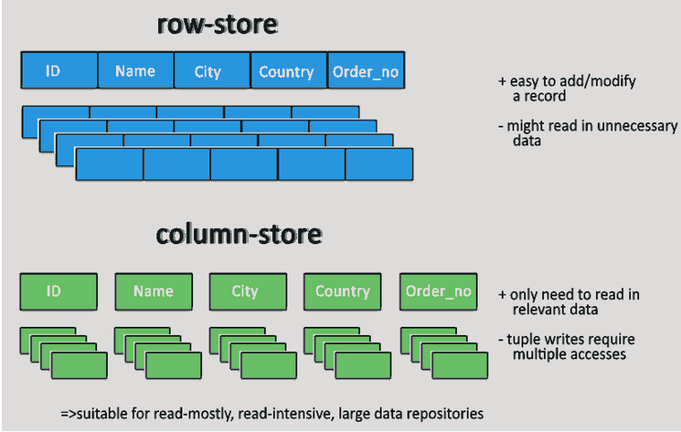

Slide 25
NoSQL Databases
Key-value stores
Column-oriented
Graph
Document oriented

Slide 26
Key-value stores
Key-value stores are most basic types of NoSQL databases.
Key value stores allow developer to store schema-less data.
In the key-value storage, database stores data as hash table where each key is unique and the value can be string, JSON, BLOB (Binary Large OBjec) etc.
A key may be strings, hashes, lists, sets, sorted sets and values are stored against these keys.
For example a key-value pair might consist of a key like "Name" that is associated with a value like "Robin".
Key-Value stores can be used as collections, dictionaries, associative arrays etc.
Key-Value stores follow the 'Availability' and 'Partition' aspects of CAP theorem.
Key-Values stores would work well for shopping cart contents, or individual values like color schemes, a landing page URI, or a default account number.

Slide 27
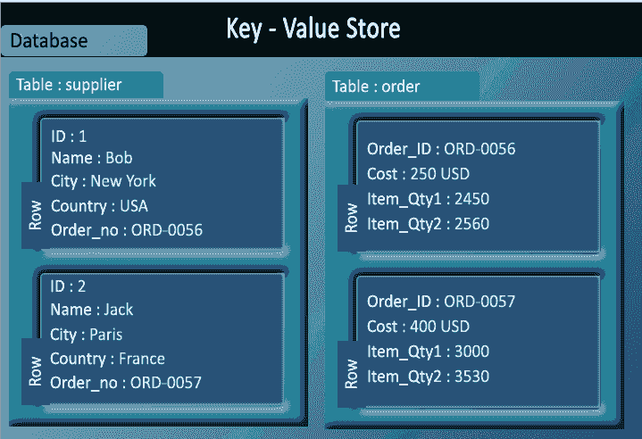
Example of Key-value store DataBase : Redis, Dynamo, Riak. etc.

Slide 28
Column-oriented databases
Column-oriented databases primarily work on columns and every column is treated individually.
Values of a single column are stored contiguously.
Column stores data in column specific files.
In Column stores, query processors work on columns too.
All data within each column data file have the same type which makes it ideal for compression.
Column stores can improve the performance of queries as it can access specific column data.
High performance on aggregation queries (e.g. COUNT, SUM, AVG, MIN, MAX).
Works on data warehouses and business intelligence, customer relationship management (CRM), Library card catalogs etc.

Slide 29
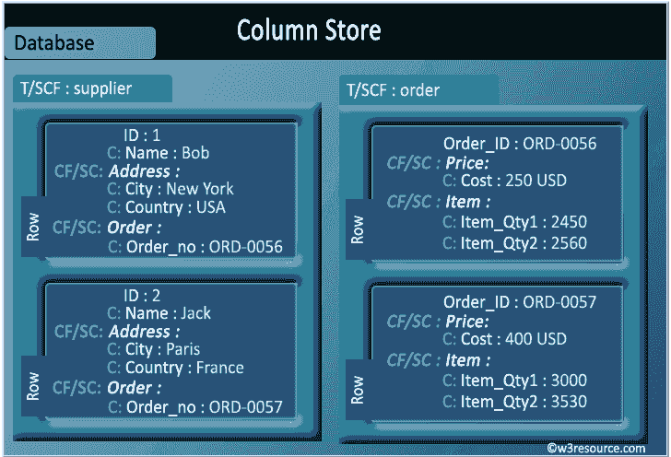
Example of Column-oriented databases : BigTable, Cassandra, SimpleDB etc.

Slide 30
Graph databases
A graph database stores data in a graph.
It is capable of elegantly representing any kind of data in a highly accessible way.
A graph database is a collection of nodes and edges
Each node represents an entity (such as a student or business) and each edge represents a connection or relationship between two nodes.
Every node and edge are defined by a unique identifier.
Each node knows its adjacent nodes.
As the number of nodes increases, the cost of a local step (or hop) remains the same.

Slide 31
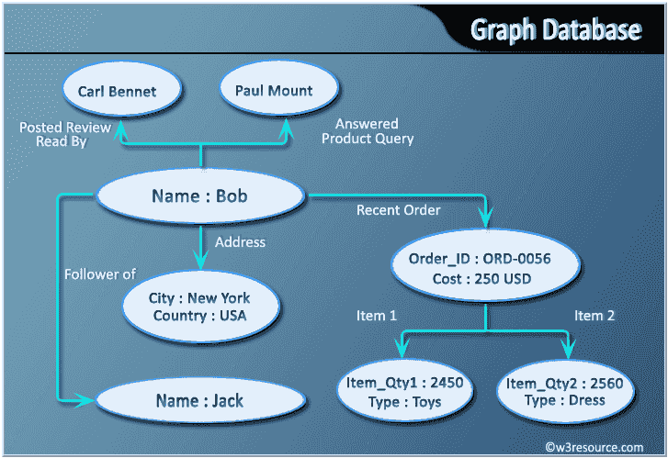
Example of Graph databases : OrientDB, Neo4J, Titan.etc.

Slide 32
Document Oriented databases
A collection of documents
Data in this model is stored inside documents.
A document is a key value collection where the key allows access to its value.
Documents are not typically forced to have a schema and therefore are flexible and easy to change.
Documents are stored into collections in order to group different kinds of data.
Documents can contain many different key-value pairs, or key-array pairs, or even nested documents.

Slide 33
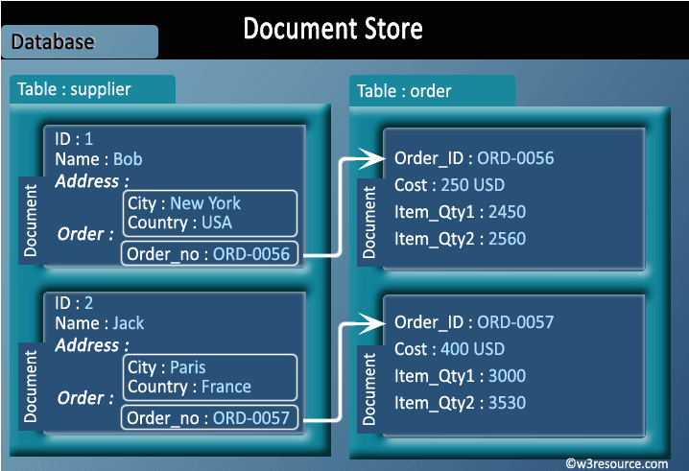
Example of Document Oriented databases : MongoDB, CouchDB etc

Slide 34
InclassExercise#1
Find out an appropriate database store for innovative assignment definition of Big Data System subject

Slide 35
Thank You

Slide 36
References
https://rubygarage.org/blog/neo4j-database-guide-with-use-cases
https://www.w3resource.com/mongodb/nosql.php
http://pages.di.unipi.it/turini/Basi%20di%20Dati/Slides/11.NoSQL-slides.pdf
https://www.guru99.com/nosql-tutorial.html

